Slide 1
Pandemics vs. Stock Market
By: Akhilesh Akula

Slide 2
Problem Statement
With COVID-19 griping everyone's lives and finances we have all noticed the financial market dive and unemployment sky rocket. The question that everyone has is when will we bounce back and are we on that track yet?
More questions come from the volatility of the market, and the question on everyone's question in the financial world is, have we hit rock bottom? In order to analyze this question, I thought it was best to look back into past pandemics that gripped the world. Although the world has never seen such a deadly virus in modern history, I want to know if there is something from the past that can help us with our future.

Slide 3
Coronavirus (Covid-19)
A respiratory disease caused by SARS-CoV-2
Puts older adults and people with sever underlying medical conditions like heart or lung disease or diabetes at a greater risk
Mainly spreads from person to person, through respiratory droplets produced from coughing or sneezing of an infected person
Another way of transmission is through direct contact of an infected surface or person and then touching your face
As the world has not seen such an aggressive and deadly virus, there is still much that we are learning on the devastation it is having on people's lives and global economies
The United States of America along with the world faced the virus since 2019

Slide 4
Ebola
Rare and deadly disease in people and non human primates
The Ebola Virus is mainly in sub-Saharan Africa
Transmitted through direct contact of blood, bodily fluids, and tissues of animals
It can also spread to other people through direct contact with anyone who is infected or has died of Ebola
The United States of America faced the virus from 2014 to 2016.

Slide 5
Swine Flu (H1N1)
A respiratory disease of pigs caused by type A influenza virus
When this virus is detected in a person, it is called Variant Influenza Virus as was seen in the 2009 Influenza Pandemic
Most commonly, transmitted to humans human infections due to exposure to infected pigs
The virus can also be transmitted through direct contact of an infected surface or person and then touching your face
The third way of transmission is through the air in droplets or dust
The United States of America faced the virus since 2009.

Slide 6
Gradient Boosting
Method that goes through cycles to iteratively add models into an ensemble
It begins by initializing the ensemble with a single model, whose predictions can be pretty naive. However, subsequent additions to the ensemble will address those errors.
Steps of Gradient Boosting:
First use the current ensemble to generate predictions for each observation in the dataset. Then we add the predictions from all models in the ensemble
The predictions are then used to calculate a loss function, which are my error values
Next we use the loss function to fit a new model that will be added to the ensemble. Specifically, I determined model parameters so that adding this new model to the ensemble will reduce the loss
Finally, we add the new model to ensemble and repeat until we have an accurate model.

Slide 7
XGBoost
An optimized distributed gradient boosting library to be highly efficient, flexible, and portable.
It implements machine learning under the Gradient Boosting framework, as it provides a parallel tree boosting to solve data science problems in a fast and accurate way.
Parameters
n_estimators → Specifies how many times to go through the modeling cycle
max_depth → Maximum depth of a tree, large value can cause overfitting
learning_rate → Shrinkage factor that avoids overfitting of the model
subsample → Subsample ratio of the training instances, it will occur once in every boosting iteration
colsample_bytree → Subsample ratio of columns when constructing each tree
colsample_bylevel → Subsample ratio of columns for each level
gamma → Minimum loss reduction required to make a futher partition of a leaf node of the tree

Slide 8
Analysis Process
Merge pandemic case count dataset and stock market dataset for each pandemic and each stock index
Create lag columns up to 21 days, this will allow a constant feed of previous prices into the XGBoost model for analysis
Split into Train, Validation, and Test Sets
60% for training and 20% for validation and testing each
Scale the data as stock prices overall are always increasing
Build XGBoost model taking into account Adjusted Close, OHLC, Range of Open and Close, Range of High and Low, Volume, and Case Count
Fit the model on the Train Set
Predict and tune using the Validation Set
Predict with tuned model on Test Set
Measure accuracy using Mean Squared Error and Mean Absolute Error
MSE → Average squared difference between the estimated values and the actual value
MAE → Measure of errors between paired observations expressing the same phenomenon

Slide 9
Libraries/Packages
TQDM
Matplotlib
Numpy
Pandas
Seaborn
Datetime
rcParams
Sklean metrics
Sklearn preprocessing
XGBoost
Mplcursors

Slide 10
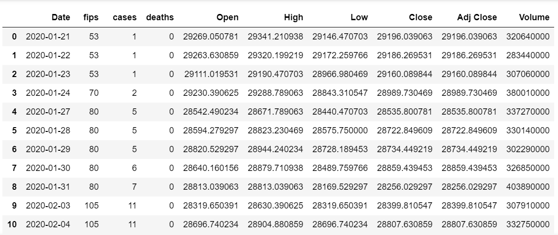
COVID19_DJI

Slide 11
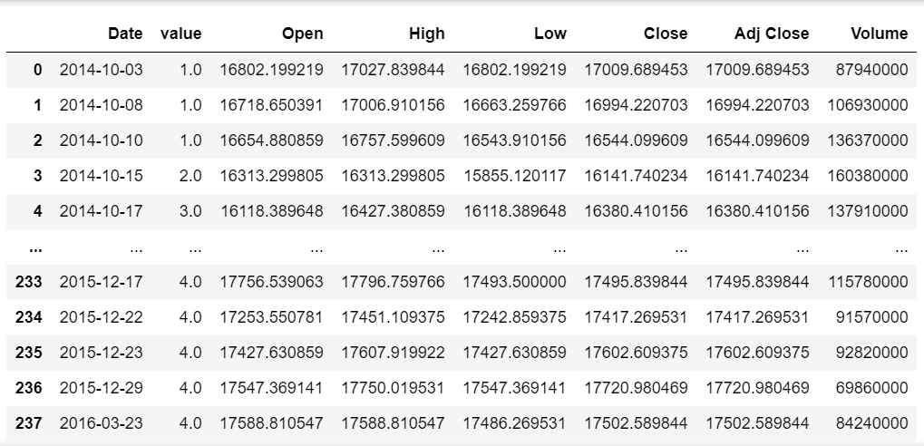
EBOLA_DJI

Slide 12
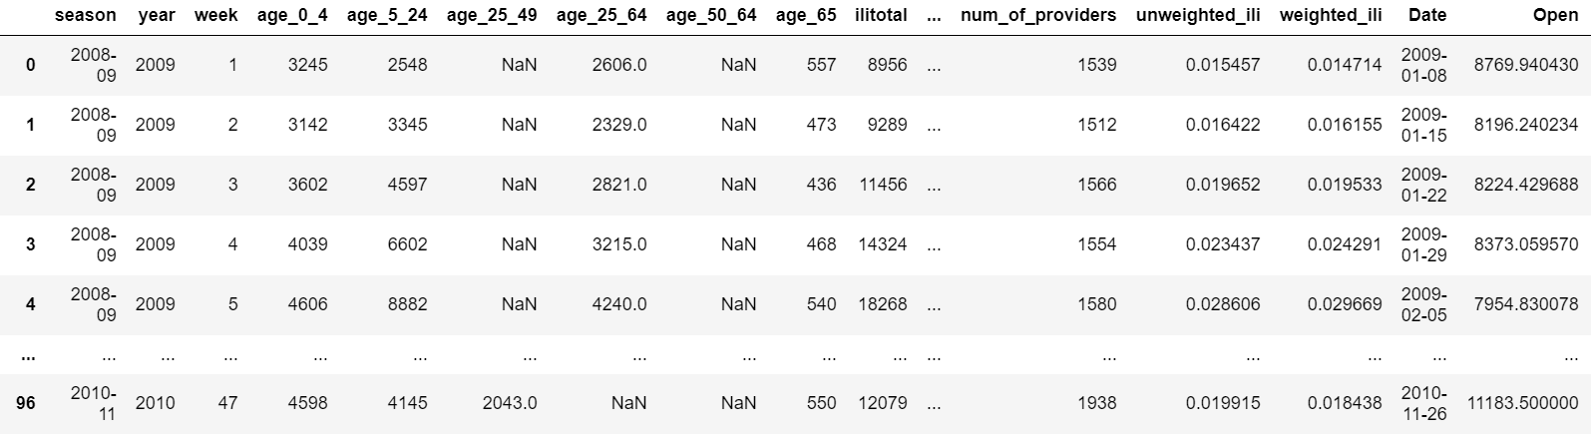
Swine_DJI

Slide 13
Graphical Representations

Slide 14
Conclusion/Analysis
Greater results with tuned XGBoost with Ebola and Swine Flue datasets
Confirms need for more data for COVID-19
Accuracy is still low, but trend predictions are much more spot on, showing that the model is on the right path
MSE Values | COVID | Ebola | Swine Flu
DJI | 2,844,446 | 1,407,766 | 552,823
S&P 500 | 43,560 | 15,988 | 7,769
NASDAQ | 481,057 | 109,647 | 64,757
MAE Values | COVID | Ebola | Swine Flu
DJI | 1,397 | 1104 | 665
S&P 500 | 182 | 117 | 75
NASDAQ | 650 | 308 | 215

Slide 15
Next Steps
Change the data that we are feeding into the model for better accuracy.
Take out OHLC data
Use news and twitter sentimental analysis
Use hospitalization and death rates along with case count
Use 10Q (Quarterly Reports), 10K (Annual Reports), cash flow statements, and any other financial statements
Although the model is not perfect there is great opportunites for improvement and make it much more accurate. As more data is released to the public over the year, and with other data incorporated into the model, I believe we can be more prepared for future pandemics that come our way.

